Slide 1
Where Are They Now?: Finding Out PDS Graduates’ Performance in their First and Second Years of Teaching
Urban Teacher Residency Partnership Program
University of South Florida
Hillsborough County Public Schools
Mrs. Tracy Wulf, Partnership Resource Teacher
Dr. Marc Summa, Partnership Resource Teacher
Mrs. Debbie Mills, Elementary School Generalist
Mrs. Kerri Levey, Collaborative Teacher

Slide 2
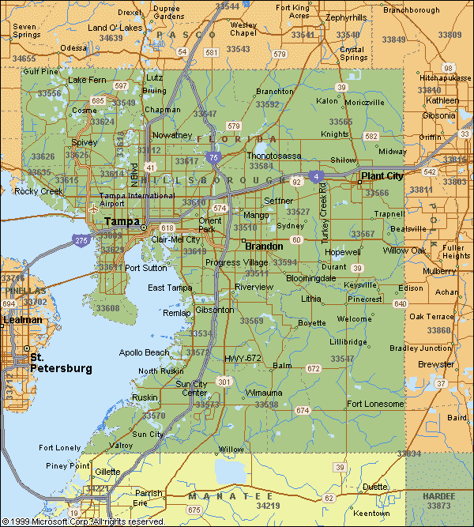
Where Are We Now?
Hillsborough County – 8th largest school district in the nation
Tampa Area
Over 200,000 students
Over 140 elementary schools
Approximately 60% of students on Free/Reduced Lunch
Hillsborough County Public Schools is the largest employer within the county with over 30,000 employees
6 partnership schools (UTRPP)
Title I, ERT, Renaissance

Slide 3
Conceptual Rationale for the Inquiry
Reflections on student teaching experiences are important to consider in trying to understand and improve student teaching practice and program effectiveness (Boyd et al., 2008; Fry, 2007).
Ryan (1979), for example, suggests that teachers have difficulty in their first year because they are undertrained for the demands of their work, there are no clear criteria in teacher training, and beginning teachers are not trained for specific jobs in specific schools (Weinstein, 1988).
The development and transition of prospective teachers from preservice training through the initial years of teaching has receive increasing attention in recent years (Marso and Pigge, 1989).
Notes:
Blogging is a constant practice. Something they are required to do every week.

Slide 4
Practical Rationale for the Study
The purpose of our inquiry is to examine UTRPP graduates from the University of South Florida’s College of Education, in their first and second year of inservice teaching, utilizing their reflections (surveys and interviews) on their performance on formal/informal district evaluations.
It is our goal to initially study the program’s graduates through qualitative data collection instruments, in order for current Partnership Resource Teachers, Collaborative Teachers, and School District personnel to better support future UTRPP graduates.

Slide 5
What is UTRPP?
Description: Urban Teacher Residency Partnership Program (UTRPP)
Residents (formerly known as interns) are selected for the program through an application process
Two-year long, full time elementary student teaching residency
Kindergarten through Fifth grade
Accumulate almost 2,000 hours of field experience time
Integrates university coursework with the realities of elementary school classrooms

Slide 6
What is UTRPP?
Description: Urban Teacher Residency Partnership Program (UTRPP)
Residents participate in field experience in the following manner:
First Year Residents – Approximately 20 hours per week
Final Year Residents – Approximately 36 hours per week
UTRPP received the following recognitions:
2014 Award for Exemplary Professional Development School Achievement from the National Association for Professional Development Schools
2014 Distinguished Program in Teacher Education Award from the Association of Teacher Educators (ATE)
2014 Spirit of Partnership Award from the University of South Carolina PDS National Conference.

Slide 7
Participants
Urban Teacher Residency Partnership Program (UTRPP)
Graduates (Alumni) from the Class of 2013
3 total
Graduates (Alumni) from the Class of 2014
15 total
Principals from Partnership Schools (Hillsborough, Pasco, and Palm Beach County School Districts)
8 total
Notes:
Tracy

Slide 8
EET Rubric Domains
Hillsborough County Public Schools
Empowering Effective Teachers evaluation instrument
Based on the Charlotte Danielson’s Framework
Domain 1: Planning and Preparation
Domain 2: The Classroom Environment
Domain 3: Instruction
Domain 4: Professional Responsibilities

Slide 9
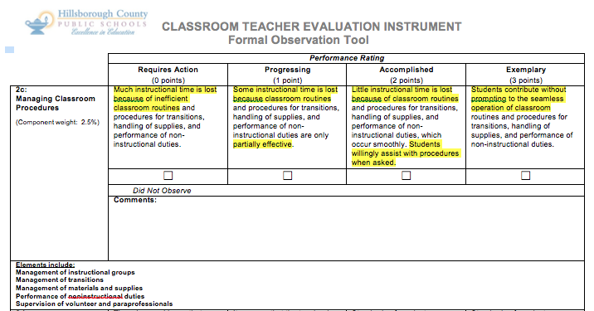
Notes:
Use this as a segway to how we created our questions for the survey.

Slide 10
Data Collection
Qualitative Data Instruments
Online surveys:
Partnership School Principals
UTRPP Graduates
Interviews with UTRPP Graduates
Notes:
Survey questions – discuss during this section. (Tracy)

Slide 11
Survey Questions – Alumni
Based on your experience in UTRPP, in what areas did you feel well prepared for the profession of teaching?
Based on your experience in UTRPP, in what areas did you feel you needed the most support in your first year(s) of teaching?
In relation to EET, where do you see your strengths within the domains? (please explain specifically for each domain)
In relation to EET, where do you see the areas in which you need support based on the domains? (please explain specifically for each domain)
What role did the following UTRPP resources play in your development as a teacher while in the program: PRT (Partnership Resource Teacher)?; CT (Collaborative Teacher)?; Content Coach?
In what ways could each of the following UTRPP resources better support your learning experiences: PRT (Partnership Resource Teacher)?; CT (Collaborative Teacher)?; Content Coach?

Slide 12
Survey Questions – Principal
Within the past two years, you have hired a graduate from UTRPP. Why do you think this person was a good candidate for your school?
When you hire a teacher, what top two qualities, characteristics or dispositions are you looking for?
In relation to EET, where do you see UTRPP graduates having strengths within the domains? (please explain specifically for each domain)
In relation to EET, where do you see UTRPP graduates needing additional support within the domains? (please explain specifically for each domain)

Slide 13
Data Analysis
After reviewing the qualitative data received from both UTRPP Alumni and
Principals at the Partnership Schools, the following data was uncovered in
Domain 1: Planning and Preparation:
 | UTRPP Alumni | UTRPP Principals
Areas of Strength | Planning Demonstrating knowledge of students, resources and technology. Demonstrating knowledge in pedagogy Designing coherent instruction | Making great gains towards learning the content Use of instructional calendar Planning with others Content knowledge Understanding data Setting instructional outcomes
Areas of Improvement | Setting instructional outcomes Designing student assessment Planning using given district resources | Knowledge of content overall for specific grades if they did not intern in the same grade Reasoning to why and how to differentiate; knowing students

Slide 14
Data Analysis
After reviewing the qualitative data received from both UTRPP Alumni and
Principals at the Partnership Schools, the following data was uncovered in
Domain 2: The Classroom Environment:
 | UTRPP Alumni | UTRPP Principals
Areas of Strength | Establishing a culture of learning Classroom set-up | Building community in the classroom Experience dealing with a variety of situations and how to handle situations Organizing physical space
Areas of Improvement | Creating an environment of respect and repertoire Managing classroom procedures Managing student behavior | Challenging behaviors in high need schools Dealing with numerous behavioral concerns so that they don’t get worse

Slide 15
Data Analysis
After reviewing the qualitative data received from both UTRPP Alumni and Principals at the Partnership Schools, the following data was uncovered in Domain 3: Instruction:
 | UTRPP Alumni | UTRPP Principals
Areas of Strength | Communicating with the students Engaging students using questioning and discussion techniques | Good gains in delivery of content and making it relevant for students Communicating with students and use of assessments Using questioning and discussion techniques
Areas of Improvement | Demonstrates flexibility and responsiveness Using assessment in instruction | Differentiated instruction Engagement Demonstrating flexibility and responsiveness

Slide 16
Data Analysis
After reviewing the qualitative data received from both UTRPP Alumni and Principals at the Partnership Schools, the following data was uncovered in Domain 4: Professional Responsibilities:
 | UTRPP Alumni | UTRPP Principals
Areas of Strength | Reflecting on teaching Showing professionalism | Very reflective in practice Working with others Handling situations as they arise Having an excellent attitude Desire to learn and grow Showing professionalism Maintaining accurate records
Areas of Improvement | Managing all of the required paperwork | Managing all of the required paperwork

Slide 17
Claims – Strengths
Based on the information provided through data collection, it was
determined that the most notable areas of strengths of graduates of UTRPP
include:
Designing Coherent Instruction (Domain 1)
Content Knowledge (Domain 1)
“You (UTRPP faculty) taught us (UTRPP Alumni) that we must anticipate where the students are going and to be responsive.” (Interview, Alumni)
“The way content was taught, it put us (UTRPP Alumni) in our student’s shoes - helped us consider a starting point and helped us take our kids where they needed to go.” (Interview, Alumni)

Slide 18
Claims – Strengths (cont.)
Designing Coherent Instruction (Domain 1)
Content Knowledge (Domain 1)
“I felt very prepared to teach math conceptually and literacy authentically.” (Survey, Alumni)
“Planning and preparedness: The program really prepared me to plan out thoughtful and meaningful lessons to meet the needs of my students across all content areas.” (Survey, Alumni)
“Graduates (of UTRPP) strengths lie in learning the content; looking at the instructional calendar and planning with others.” (Survey, Principal)
Notes:
Refer to 1c in the EET Rubric: Setting Instructional Outcomes

Slide 19
Claims – Strengths (cont.)
Building Community in the Classroom (Domain 2)
Organizing Physical Space (Domain 2)
“If you want a student-centered classroom, you have to establish community.” (Interview, Alumni)
“My classroom would fail without it (building a classroom community)!” (Interview, Alumni)
“Community is a mind-set. It is an all-day, everyday occurrence.” (Interview, Alumni)
“Graduates (of UTRPP) have a great ability to build community in the classroom.” (Survey, Principal)
Notes:
Megan’s story (Tracy)

Slide 20
Claims – Strengths (cont.)
Building Community in the Classroom (Domain 2)
Organizing Physical Space (Domain 2)
“It is important to organize space which is conducive to your class and their (the students) learning style. It should compliment your teaching style which meets the needs of students.” (Interview, Alumni)
“I felt most prepared for classroom management and setting up my classroom. The experience in UTRPP definitely prepared me for classroom management situations in the classroom. It also made preplanning a whole lot easier.” (Survey, Alumni)
Notes:
Megan’s story (Tracy)

Slide 21
Claims – Strengths (cont.)
Communicating with Students (Domain 3)
Using Questioning and Discussion Techniques (Domain 3)
“We learned how to teach our students to learn from one-another using accountable talk during classroom discussions.” (Interview, Alumni)
“When communicating with students, it is important to show them empathy and structure.” (Interview, Alumni)
“UTRPP graduates have a strong ability to use questioning and discussion techniques in their instructional delivery.” (Survey, Principal)
Notes:
Refer to 3b in EET Rubric: Using Questioning and Discussion Techniques

Slide 22
Claims – Strengths (cont.)
Reflecting on Teaching (Domain 4)
Professionalism (Domain 4)
“UTRPP has made reflection a natural part of my life.” (Interview, Alumni)
“I felt I was taught a lot about why teachers teach the things they do and how to best teach them across all subject areas.” (Survey, Alumni)
“Domain 4 is reflection and professionalism and I believe that the residency made me the reflective teacher I am today.” (Survey, Alumni)
“Graduates are able to thoroughly reflect on their lessons.” (Survey, Principal)

Slide 23
Claims – Strengths (cont.)
Reflecting on Teaching (Domain 4)
Professionalism (Domain 4)
“Very reflective! My teachers (UTRPP graduates) are experienced in how to handle situations and work with others - both integral parts of being a true professional. ” (Survey, Principal)
“I took this fifth grade position in an urban school because I knew I could handle it. My principal has selected my classroom as one of seven rooms in our school as a model room for classroom management and had a few first year teachers come in and observe. During state and district walkthroughs, I was told that my classroom was one of the best examples of what they were looking for in math and reading.” (Survey, Alumni)
Notes:
Refer to 4b and 4f: Communicating with Stakeholders/Showing Professionalism

Slide 24
Implications
Based on the information provided through data collection, it was determined that the most notable areas for improvements necessary for future graduates of UTRPP include:
Knowledge of Content across all Grade levels (Domain 1)
Vertically Planning Opportunities
Managing Challenging behaviors (Domain 2)
Providing Strategies and Coaching in Field Experience
Flexibility and Responsiveness (Domain 3)
Area of Focus for Future Observations/Planning
Managing required paperwork (Domain 4)
RtI (Response to Intervention) Process/Implementation

Slide 25
Future Wonderings
What does this mean for the role of the Partnership Resource Teacher, Collaborative Teacher and School District Personnel in UTRPP?
How will this information be used in the future for the University of South Florida’s College of Education and Hillsborough County Public Schools partnership?

Slide 26
Any questions???
Thank you for your time! If you have any further questions, please feel free to contact us at any time!
Mrs. Tracy Wulf Dr. Marc Summa
Partnership Resource Teacher Partnership Resource Teacher
UTRPP @ USF/HCPS UTRPP @ USF/HCPS
twulf@usf.edu summam@mail.usf.edu
Mrs. Debbie Mills Mrs. Kerri Levey
Elementary Generalist Collaborating Teacher
Hillsborough County Public Schools Pizzo Elementary School
debbie.mills@sdhc.k12.fl.us kerri.levey@sdhc.k12.fl.us

Slide 27
References
Boyd, D., Grossman, P., Hammerness, K., Lankford, R., Loeb, S., Mcdonald, M.,
... Wyckoff, J. (2008). Surveying the Landscape of Teacher Education in
New York City: Constrained Variation and the Challenge of Innovation.
Educational Evaluation and Policy Analysis, 319-343.
Cole, A., & Knowles, J. (1993). Shattered images: Understanding expectations
and realities of field experiences. Teaching and Teacher Education, 9(5/6),
457-471.
Freeman, J., Simonsen, B., Briere, D., & Macsuga-Gage, A. (2014). Pre-Service
Teacher Training in Classroom Management: A Review of State Accreditation Policy and Teacher Preparation Programs. Teacher Education and Special Education, 37(2), 106-120.

Slide 28
References
Fry, S. (2007). First-Year Teachers and Induction Support: Ups, Downs, and
In-Betweens. The Qualitative Report, 12(2), 216-237. Retrieved January 1,
2015, from http://www.nova.edu/ssss/QR/QR12-2/fry.pdf
HillsboroughCTA. (2012, January 1). Retrieved March 2, 2015, from
http://www.hillsboroughcta.org/index.php/eet
Hoskins, J., Schuette, C., & Charlton, M. (2011, August 17). Program
Improvement and Practice: In-Service and Pre-Service Student Teaching Reflections. Retrieved January 5, 2015, from http://icctejournal.org/issues/v6i2/v6i2-hoskins-schuette-charlton/

Slide 29
References
Kagan, D. (1992). Professional Growth Among Preservice and
Beginning Teachers. Review of Educational Research, 62(2), 129-169.
Marso, R., & Pigge, F. (1989). The influence of preservice training and teaching
experience upon attitude and concerns about teaching. Teaching and Teacher Education, 5(1), 33-41.

