Slide 1
Building Partnership Capacity Through Teacher Leadership
The Urban Teacher Residency Partnership Program (UTRPP) Teacher Leadership Cohort
Marc J. Summa, Ed. D.
Tracy Wulf
Rebecca West Burns, Ph. D.
Shanna-Lee Fair
Carol Tormoehlen

Slide 2
What Does the Research Say?
“An organizational structure/arrangement must be in place that not only guides the work of the PDS but also allows for and encourages collaboration, reflection, and regular communication among participants (NAPDS, 2008).“
“Through PDS partnerships, new approaches for examining and improving practices are gained through integrating partners’ expertise and knowledge of practice (Carpenter, B. D. & Sherretz, C. E., 2012).”
“PDS experiences improve host teachers’ perceptions of themselves as professionals. (NAPDS, 2015).”
“While PDSs focus, in part, on the preparation of new teachers, they also provide a venue for professional development of educators already in the field. Thus, continuous learning focused on an engaged community of learners is a critical feature of a PDS (NAPDS, 2008)”
Notes:
M

Slide 3
What is UTRPP?
Description: Urban Teacher Residency Partnership Program (UTRPP)
Residents are selected for the program through an application process
Residents Contracted 7:30am – 3:30pm / Monday through Friday
Two-year long, full time elementary (K-5) residency
Accumulate almost 2,000 hours of clinical experience
Daily Classroom Experiences Alongside a Collaborative Teacher
Daily Supervision/Support Alongside a Partnership Resource Teacher
Integrate university coursework with the realities of elementary school classrooms
Notes:
Present at the National Association of Professional Development Schools Conference – March 2016
Presentations at the University of South Florida Inquiry Conference – April 2016
Hands-On Content Coaching Cycles (Final Year Residents Only)
One 5-week cycle in the Fall Semester
Three 2-week cycles in the Spring Semester
Science, Literacy and Mathematics

Slide 4
UTRPP Teacher Leadership Cohort
Mort
Witter
MOSI
UTRPP
TL
Shaw
Patel
Pizzo
Notes:
T

Slide 5
Comparing Schools
UTRPP School Statistics
School | Mort | Pizzo | USF/Patel | Witter | Shaw | MOSI
Title 1 | Yes | Yes | Yes | Yes | Yes | Yes
Number of UTRPP Collaborative Teachers | 12 | 6 | 4 | 5 | 0 | 2
Number of K-5 Students | 832 | 759 | 205 | 617 | 748 | 257
Demographics in K-5 Schools | White 109 Black 222 Hispanic 422 Other 27 | White 81 Black 339 Hispanic 279 Other 60 | White 35 Black 102 Hispanic 44 Other 24 | White 45 Black 324 Hispanic 203 Other 45 | White 43 Black 419 Hispanic 245 Other 41 | White 12 Black 120 Hispanic 103 Other 22
Notes:
T

Slide 6
Participants
13 Female Elementary Teachers
Representing 4 of 6 partnership schools.
Five Members in Year 2 of Teacher Leadership Coursework
Eight Members in Year 1 of Teacher Leadership Coursework
Teacher Experience Ranges from 5 years to seventeen years across all grade levels (K - 5)
Five Members Hosting First Year Residents
Eight Members Hosting Final Year Residents
Notes:
M

Slide 7
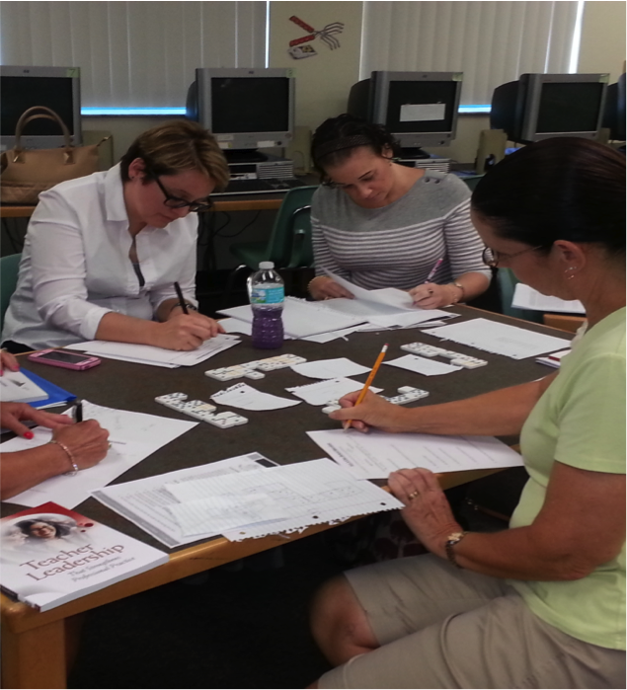
USF Teacher Leadership
Graduate Certificate
Four Courses:
Teacher Leadership for Student Learning
Coaching for Student Learning
Teacher Research for Student Learning
Professional Development for Student Learning
Notes:
M

Slide 8
Goals of
Teacher Leadership Certificate
Goals of a Teacher Leadership Certificate
Assume formal and informal leadership roles
Engage in and lead teacher research
Work with adult learners through coaching peers and preservice teachers for student learning
Facilitate high quality, job-embedded, school-based professional development
Notes:
M

Slide 9
Participant Selection
Collaborative Teacher/ Teacher Leader Qualifications
Desire to Earn Teacher Leadership Certificate
Principal Recommendation
Collaborative Teacher Voucher
Highly Effective Teacher Rating (HCPS EET Rubric)
3 Years of Teaching Experience
Notes:
C AND S

Slide 10
Inquiry Questions
How can we create a cadre of teacher leaders across the Urban Teacher Residency Partnership Program?
What similarities and differences are there from this cohort as compared to the initial cadre?
What challenges do the teacher leaders face as they work within and across schools?
What are the successes of the program to date?
Notes:
M

Slide 11
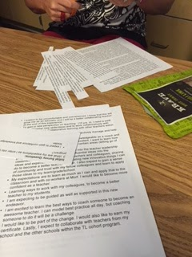
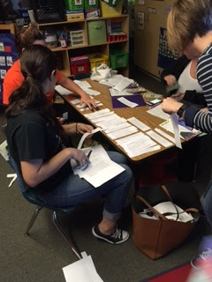
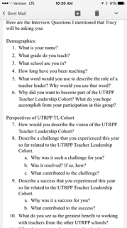
Data Collection
Initial Surveys
Interviews
Range 6 min - 20 min
Audio recorded
Transcribed
Documents
Power Points of Previous Inquiries
Field Notes
Student Work Samples
Notes:
T

Slide 12
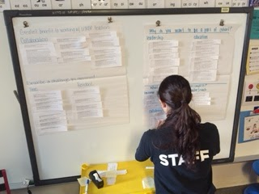
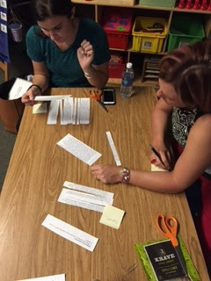
Data Analysis
Interviews and surveys were separated by question
Responses were grouped and categorized to create initial claims
Documents were analyzed for similarities and differences
Categories from different data sources were grouped to develop themes
Notes:
C AND S

Slide 13
Claims and Evidence
What similarities and differences are there from this cohort as compared to the initial cadre?

Slide 14
Claims and Evidence
Similarities
Content focused on developing teachers pedagogies of teacher education (mentoring skills as collaborating teachers)
“We learned about different strategies to start the year off with the resident, but also how to co-teach in the classroom…… We have been working on different co-teaching strategies, like one-teach and one-guide.”
Some similar issues across schools (Time)
“...Every single time we meet it comes up that it is just a lack of time. It’s not that we aren’t interested, we are invested, we want to do those things….how do we fit it all in?”
Notes:
M, C AND S

Slide 15
Claims and Evidence
Similarities
Both groups reported learning new knowledge and being able to immediately apply that knowledge
“I had a major ‘aha’ moment around October or November in regard to how I communicated with my resident and I learned that through UTRPP how I was being very negative. It had to do with lack of time-demands as far as just demands on me. I really had to change my whole attitude and how I was communicating and dealing, not dealing, but really dealing with my resident and things she had to do. Just by changing like through conversation in UTRPP- conversations with peres kind of brainstorming and problem solving- I was able to take a step back and really kind of see that I needed to change my ways of talking and communicating. That really changed our relationship, it really turned everything the other way and it started going up positively.”
Notes:
M, C AND S

Slide 16
Claims and Evidence
Similarities
Actively solving challenges with peers
“ I think working with others and listening to other people that are doing exactly what I am doing and hearing their stories and the ways that they dealt with similar challenges was really helpful. Just being able to hear from others and being able to collaborate with them.”
“It feels like a group effort. I think it is power in numbers if you have people who are with you and behind you then you feel a little bit more motivated to want to change and to do what’s best for your kids and your resident.”
Notes:
C AND S

Slide 17
Claims and Evidence
Similarities
Inquiry remains a signature pedagogy (annual collaborative inquiry and dissemination)
“Last year the cadre focus seemed to be more like on PLCs even though we were still collaborating, there was more of a focus on PLCs. This year we are focusing more on inquiry and coaching.”
Notes:
C AND S

Slide 18
Claims and Evidence
Differences
The foci remain different - one was school driven and one remains course driven
“Last year the cadre focus seemed to be more like on PLCs even though we were still collaborating, there was more of a focus on PLCs. This year we are focusing more on inquiry and coaching.”
Notes:
M

Slide 19
Claims and Evidence
Differences
Building community across schools takes time and attention and is still developing
“ I think last years experience, being that we were all from the same school, I felt a little bit more of a personal connection with everybody in the way that we kind of did icebreakers and did a lot of getting to know you activities….”
Teachers must travel to other school sites
“Meeting place, switching it up, hard for travel purposes and to go back to the classroom to prepare.”
Notes:
M C AND S

Slide 20
Claims and Evidence
What challenges do the teacher leaders face as they work within and across schools?

Slide 21
Claims and Evidence
Challenges
TLs face two main challenges that are present both within their school and across schools.
Time
“A challenge is time. Finding the time to really work together.”
“TIME – inquiry, workload, coaching, co-­planning, co­-preparing.”
Managing their role as a collaborating teachers
“A challenge I had this year was stemming from a challenge I had last year with my resident. Not setting expectations at the beginning of the year so that is something we discussed in cohort and how we were going to implement that.”
Notes:
C AND S

Slide 22
Claims and Evidence
What are the successes of the program to date?

Slide 23
Claims and Evidence
Successes
TL Cohort has created a “back porch” (Dana & Yendol-Hoppey, 2015). Teachers share stories and strategies related to teaching and mentoring.
“Being with other schools, we can see that the issues we face are universal. Sometimes, we feel that it is just site-based, but it is across the partnership. We can have deep conversation with other partnership CT’s (collaborative teachers.) We gain a variety of perspectives.”
Notes:
M C AND S

Slide 24
Claims and Evidence
Successes
TL Cohort has served as a mechanism for professional renewal for teachers.
“Can be energizing to hear and feel what each other thinks through both discussion and online discussion board.”
“ I felt as though I was becoming complacent in my job as a teacher so I wanted to push myself a little further as far as helping myself, my resident and seeing what I could do to help other at my school as well.”
“I decided to participate in this to grow further with teacher leadership skills and I felt like this program was a good way to challenge myself and further develop my career as a teacher.”
Notes:
M C AND S

Slide 25
Implications
Improve the communication between the Teacher Leadership program and the UTRPP Leadership Team.
Reorganization of time that is allocated for the UTRPP Teacher Leadership Cohort.
Notes:
all

Slide 26
Future Wonderings
In Year 2, how can we move the Teacher Leadership Cohort to examine inquiry across partnership schools instead of site-based inquiry?
How do we empower Teacher Leaders to have more of a voice within the leadership of the partnership?
How do we continue to recruit and sustain Teacher Leadership?
What does Teacher leadership look like amongst Professional Development Schools?
Notes:
ALL

Slide 27
Any questions???
Thank you for your time! If you have any further questions, please feel free to contact us at any time!

Slide 28
Mrs. Tracy Wulf Dr. Marc J. Summa Partnership Resource Teacher Partnership Resource Teacher UTRPP @ USF/HCPS UTRPP @ USF/HCPS twulf@usf.edu summam@mail.usf.edu Dr. Rebecca West Burns Mrs. Shanna-Lee Fair Assistant Professor Kindergarten Teacher University of South Florida Pizzo Elementary School rebeccaburns@usf.edu shanna-lee.fair@sdhc.k12.fl.us Ms. Carol Tormoehlen 2nd Grade Teacher USF Patel Partnership School carol.tormoehlen@sdhc.k12.fl.us
Contact Information

Slide 29
References
Carpenter, B. D. & Sherretz, C. E. (2012). Professional Development School
Partnerships: An Instrument for Teacher Leadership. School— University Partnerships Vol. 5, No. 1. Retrieved from ERIC: EJ974371
NAPDS (2015). Professional Development School (PDS) Evidenced-Based
Claims . Web retrieved from: http://napds.org/wp-content/uploads/ 2015/03/PDS.Claims.Document.MSUB_.3.8.15.pdf
NAPDS (2008).What it means to be a professional development school. Web retrieved from: http://napds.org/wp-content/uploads/2014/10/ Nine-Essentials.pdf

