Slide 1
Empowering Teacher Leaders Across A Partnership of Urban Schools
The Urban Teacher
Leadership Academy
(UTLA)
Marc J. Summa, Ed. D.
Kimberly Billett
Karen Dansby
Beth Hatzifrangou
Andrea Jones-Lang
Notes:
Introductions (name, position, school):
Marc
Kim
Karen
Andrea
Beth

Slide 2
What is Teacher Leadership?
“A teacher-leader is someone who wants to make a difference, encourages colleagues to be motivated, and making contributions to the improvement of teaching and learning.” (Cowdery, 2004)
“A teacher leader is a teacher that empowers all stakeholders to collaborate and enhance the climate and culture of the school and surrounding community through partnership work.” (UTLA, 2016)
Notes:
Hatz: After reading the literary quote – include the following citation: According to Cowdery, “this characterization is in contrast to the previously held idea of a teacher-leader as a pseud-administrator or ‘head-teacher’”. To increase teacher job satisfaction, school administrators and policy makers need to enhance teacher empowerment and support. Teacher dissatisfaction is evident in statistics that show half of all new teachers leave the field within the first three years (quoted by Hirsch 2002). This characterization is in contrast to the previously held idea of a teacher-leader as a pseudo-administrator or "head teacher”. The general perception of a teacher-leader today seems to be of a teacher who encourages collaborative decision-making within his or her school community by virtue of relational influence. A teacher-leader perceives his or her role as not only an educator in the classroom but as an educator among peers. A teacher-leader is someone who wants to make a difference, encourages colleagues to be motivated, and makes a contribution to the improvement of teaching and learning. Teacher-leaders "someone who has positive relations with all people in all areas of the school and is able to present ideas to them and to value their opinions. The school principal is critical to the successful nurturing of teacher-leaders. The tone that the principal sets ripples throughout the entire school. The principal fosters teacher-leaders by supporting teachers and encouraging them to take prominent roles in the school. It must be conscious choice on the part of a school principal to enhance student effectiveness through shared responsibility and trust in the ability of his or her teachers. Many teachers are passive or even resistant to change for varying reasons. To develop teacher-leaders, the opportunity for leadership must exist, and it must be nurtured. Teacher-leaders only can emerge in an environment designed to promote and reward teacher leadership.

Slide 3
Our Purpose for Inquiry
Empowering teachers to take on leadership roles enhances teachers' self esteem and work satisfaction, which in turn leads to higher levels of performance due to higher motivation, as well as possibly higher levels of retention in the profession (Muijis & Harris, 2003).
*The purpose of our inquiry is grounded in the belief that, as a collaborating team of teacher leaders, our talents and treasures must be tapped into to have a positive impact across our partnership schools in the form of on-going, job-embedded professional development, not mutually exclusive to a select few, but for all stakeholders to model for our pre-service teachers and exemplify for our classroom students in which we have the great responsibility for educating.
Notes:
Hatz – (Read the quote)
Billett – (Read the purpose) At my school, we are at the end of our Power 3 grant for our Teacher Leaders, so we are trying to empower multiple teachers to take on the teacher leader roles and share their expertise with one another. The Teacher Leader role is no longer on ONE person’s shoulders, but shared throughout the faculty.

Slide 4
Claims and Evidence
Elevating Teacher Leadership (Killion, et. al., 2016)
Component 1: Definition of teacher leadership purpose, roles and responsibilities
Rationale
Efforts to initiate or refine teacher leadership begins with clarity of goals and purpose, it is often necessary to define what the concept of teacher leadership is and to describe how it looks in action.
“Deliberate attention to planning for successful teacher leadership requires collaboration among stakeholders, including, at a minimum, teachers, principals, central office staff, and teacher association representatives, to specify the purpose and outcomes of teacher leadership within the education system; define teacher leadership; determine the roles and responsibilities for teacher leaders; and establish the policies and conditions for success.”
Notes:
Marc: We will be examining teacher leadership and how to empower teacher leaders to have a voice in their schools, as well as across a partnership within a school district. Furthermore, we will use the work of Killion, and her associates, to provide a framework as to our collective thoughts and discussion. It is with this work, along with the work of many other publications, which will provide support to our claims and evidence throughout our presentation. (Read both stars for the Rationale)
ALL: Elaborate on this component

Slide 5
What is UTRPP?
The Urban Teacher Residency Partnership Program (UTRPP) is a partnership between the University of South Florida and Hillsborough County Public Schools, designed to provide high-intensity, job-embedded professional development, through rigorous coursework and field experience, to pre-service teachers, known as residents.
Notes:
Marc – (Read the explanation) - Residents are selected for the program through an application process. They are contracted by Hillsborough County Public Schools and USF for field experience and coursework from 7:30am – 3:30pm, Monday through Friday, allowing for the residents to work, if they need to, in order to support their financial needs. Residents do receive a small stipend each semester to off-set some costs, but most still have to work. UTRPP is a two-year long, full-time elementary (K-5) residency in which they accumulate almost 2,000 hours of clinical experience through daily classroom experiences alongside a Collaborating Teacher who was selected by their administration based on a highly-effective rating and clinical education training. Residents receive daily supervision and support alongside a Partnership Resource Teacher. Residents integrate university coursework with the realities of elementary school classrooms. Final year residents have the opportunity to present at this conference (National Association of Professional Development Schools Conference – March 2017), as well as at the University of South Florida’s Practitioners’ Inquiry Conference this April. Final year residents receive hands-on Content Coaching Cycles in the areas of literacy, science and mathematics (one 5-week cycle in the Fall Semester and three 2-week cycles in the Spring Semester).

Slide 6
UTRPP Schools
Mort
Witter
MOSI
UTRPP
Shaw
USF-Patel
Pizzo
Notes:
Dansby: Currently there are 6 schools in Hillsborough County that participate in the UTRPP partnership. Four of the schools in the partnership have teachers who participate in UTLA and who are working towards becoming teacher leaders in their schools.
Marc: briefly discuss the partnership schools involved in UTRPP (explain Shaw and MOSI)

Slide 7
Comparing Schools
UTRPP School Statistics (2016)
School | Mort | Pizzo | USF-Patel | Witter | Shaw | MOSI
Title 1 | Yes | Yes | No | Yes | Yes | Yes
Number of UTRPP Collaborating Teachers | 11 | 11 | 4 | 8 | 4 | 3
Number of Teachers | 49 | 37 | 12 | 29 | 34 | 18
Demographics in K-5 Schools | Total 832 White 109 Black 222 Hispanic 422 Other 27 | Total 759 White 81 Black 339 Hispanic 279 Other 60 | Total 205 White 35 Black 102 Hispanic 44 Other 24 | Total 617 White 45 Black 324 Hispanic 203 Other 45 | Total 748 White 43 Black 419 Hispanic 245 Other 41 | Total 257 White 12 Black 120 Hispanic 103 Other 22
Notes:
Andrea: Here we have a breakdown of the data across our partnership schools. Please focus your attention on the number of Collaborating Teachers versus the number of teachers at each school. It is important to note that our goal is to reach all of these teachers, in some capacity, to identify with UTRPP and become a part of UTLA.

Slide 8
UTRPP: Shared Responsibilities
Residents
(First & Final Year)
Collaborating Teachers
Teacher Leadership (MTLA/UTLA)
UTRPP
Program Directors/Advisory Board
Partnership Resource Teachers
Content Coaches/Course Instructors
Notes:
Marc: (Read each of the groups and what their roles include)

Slide 9
UTRPP Teacher Leadership
MTLA
Mort Teacher Leadership Academy
Pilot program – One Partnership School
Internationally and Nationally Recognized Inquiry Work
Phase 2 and 3 of Graduate Level Coursework (Completed Teacher Leadership Certification)
Community School Model
Host Both First and Final Year Residents
UTLA
Urban Teacher Leadership Academy
Spawned program – Four Partnership Schools
Nationally Recognized Inquiry Work
Teacher Leadership Certification: Phase 1 of Graduate Level Coursework
Partnership School Model
Host Both First and Final Year Residents
Notes:
Dansby: Mort was the very first partnership school. The administration at Mort piloted the Teacher Leadership Program with several of the teachers from Mort. This is how MTLA was developed. From one partnership school the program has now grown to encompass 3 additional schools from the surrounding area. UTLA allows teachers from different schools to collaborate and communicate about how we can empower and motivate our teachers at the various sites to join UTLA and continue building strong teacher leadership from within the current teaching staff.

Slide 10
Participant Selection
Collaborating Teacher/ Teacher Leader Qualifications
Desire to Earn Teacher Leadership Certificate
Principal Recommendation
Collaborative Teacher Voucher
Highly Effective Teacher Rating (HCPS EET Rubric)
3 Years of Teaching Experience
Notes:
Billett: (Read each of the ways in which teacher leaders are selected)

Slide 11
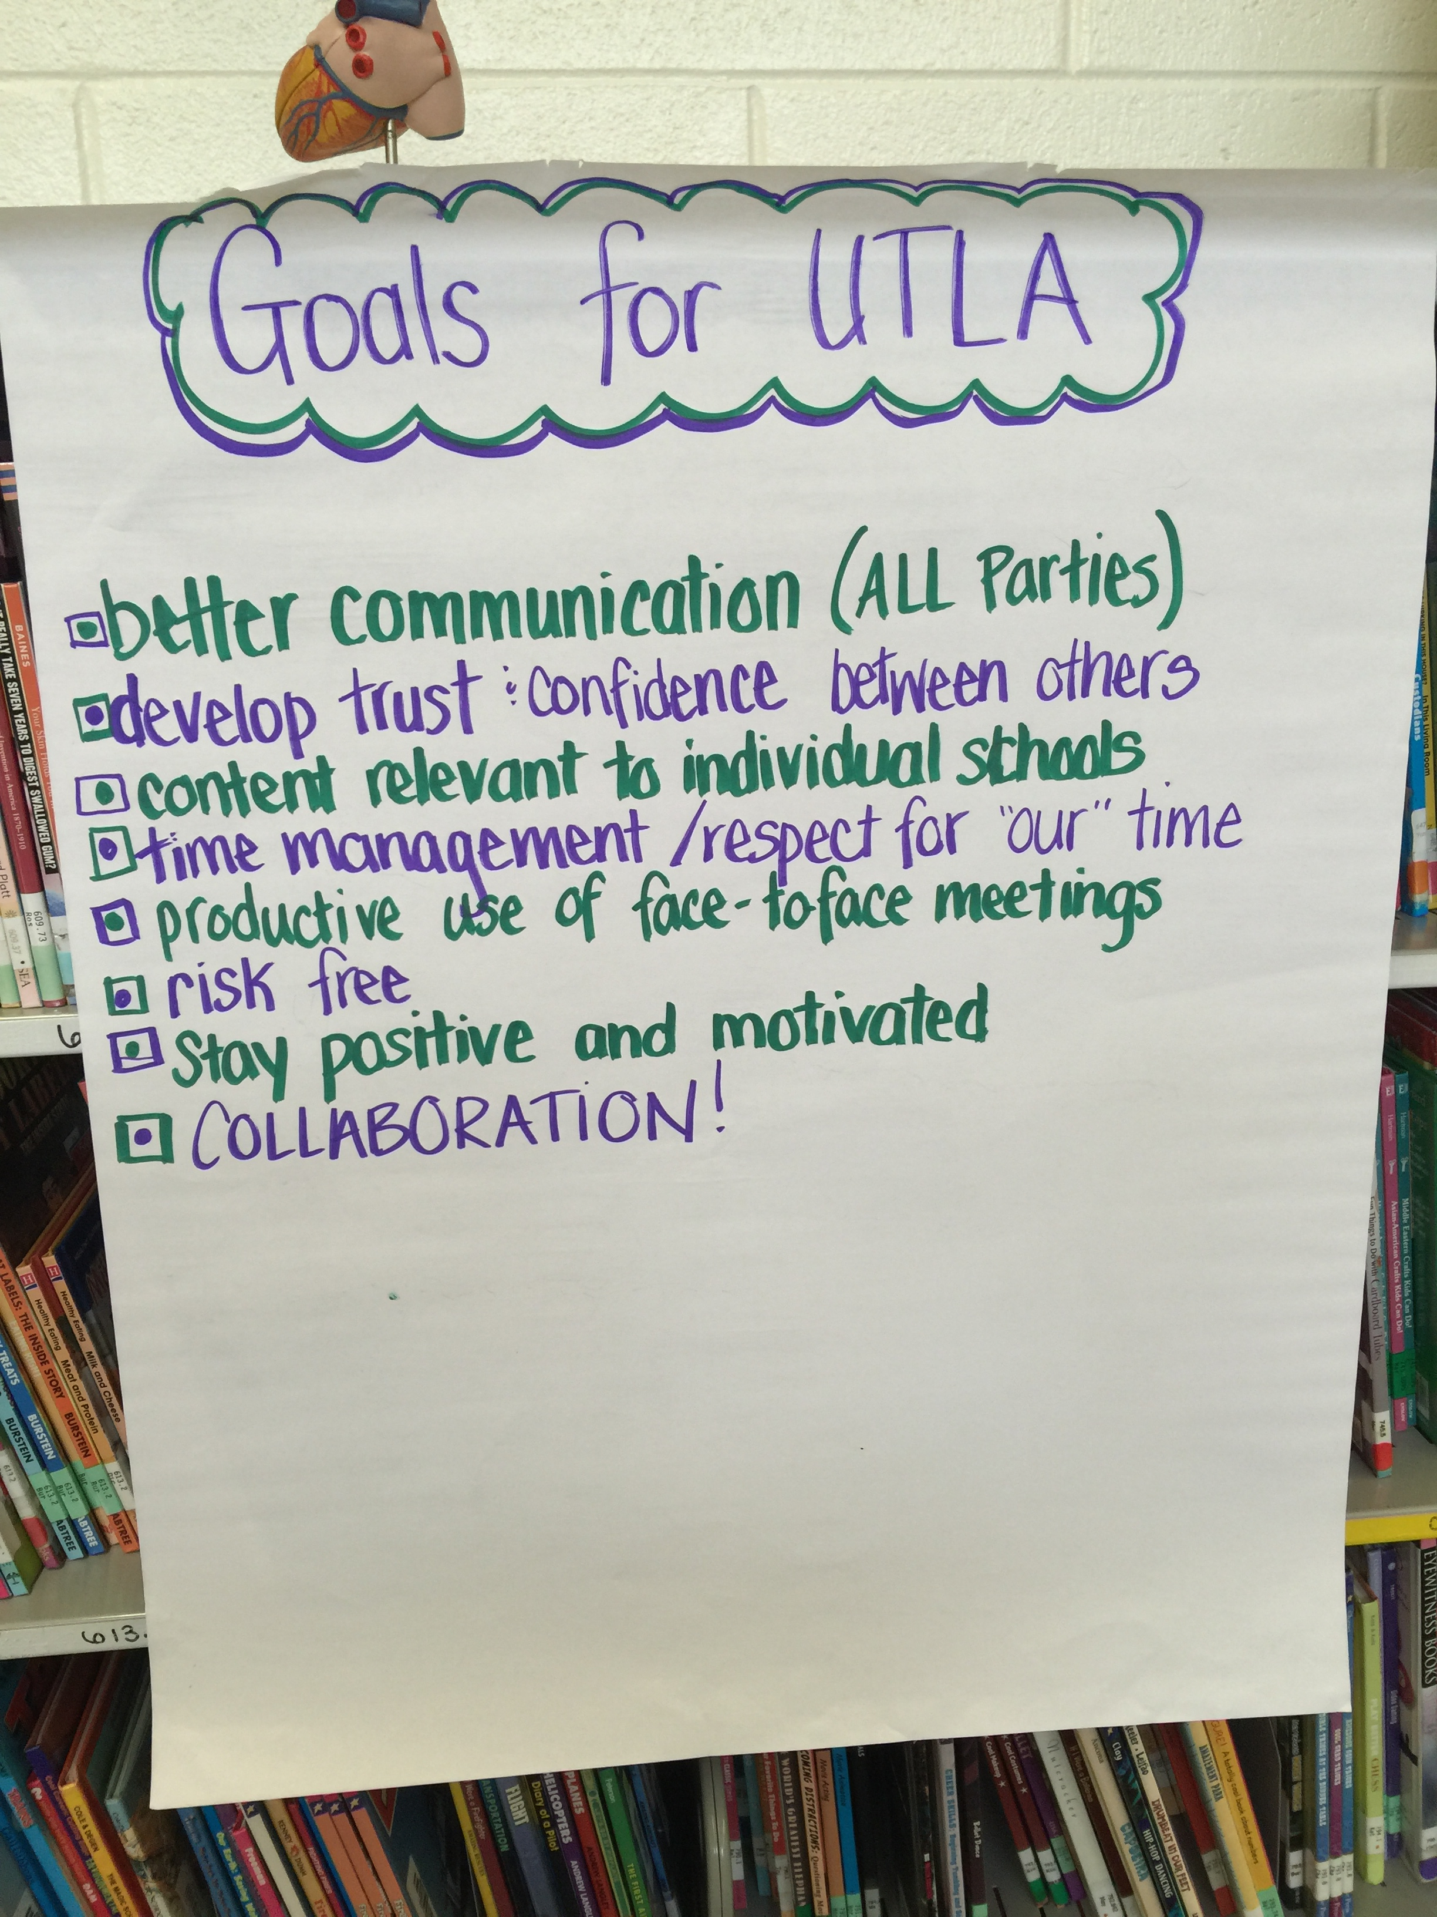
USF Teacher Leadership
Graduate Certificate
Four Courses:
Teacher Leadership for Student Learning
Coaching for Student Learning
Teacher Research for Student Learning
Professional Development for Student Learning
Notes:
Andrea: (Briefly discuss the four courses) These are the four courses which make up the Teacher Leadership Certificate. This school year we are focused on Teacher Leadership for Student Learning and Professional Development for Student Learning. Next school year, we will work on the Coaching and Research side of Teacher Leadership. Ultimately, our work in this certification program will lead us to further educational and professional opportunities.

Slide 12
Goals of
Teacher Leadership Certificate
Goals of a Teacher Leadership Certificate
Assume formal and informal leadership roles
Engage in and lead teacher research
Work with adult learners through coaching peers and preservice teachers for student learning
Facilitate high quality, job-embedded, school-based professional development
Notes:
Marc: Discuss the Goals of Teacher Leadership Certification.

Slide 13
Inquiry Questions
How can we empower Collaborating Teachers, through the Urban Teacher Leadership Academy, to be a voice in the Urban Teacher Residency Partnership Program?
What level of support is necessary from site-based administration, across partnership schools, to create a system of collaboration amongst current and future teacher leaders?
How can UTRPP stakeholders effectively communicate, to site-based faculty and staff, the connection of the partnership and the development of future Teacher Leaders?
How can Teacher Leaders utilize their leadership qualities to positively impact those who lack the awareness of participation in partnership collaborative work?
Notes:
Andrea: Read Inquiry Question
Dansby: Read STAR 1
Hatz: Read STAR 2
Billett: Read STAR 3

Slide 14
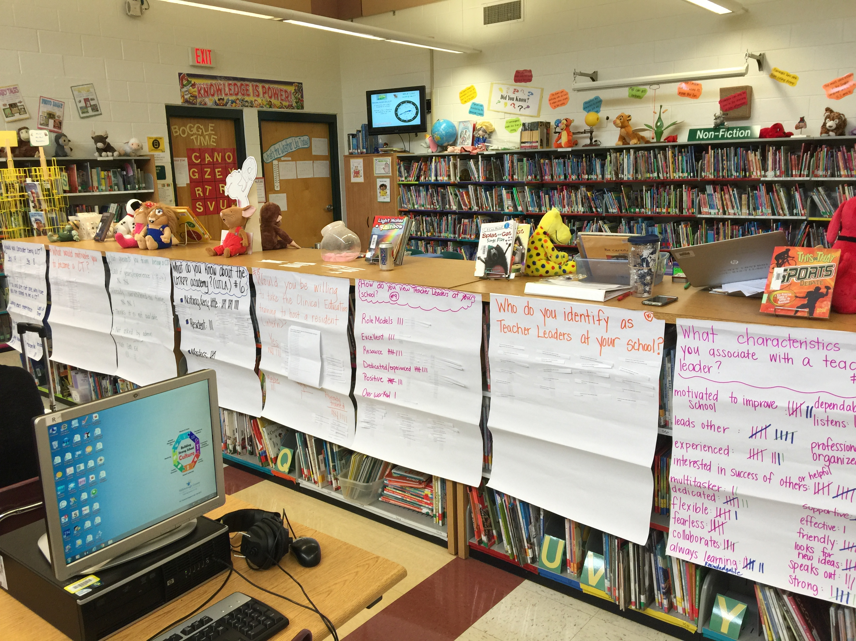
Data Collection
Initial Surveys
Interviews
Range 6 min - 20 min
Audio recorded
Transcribed
Documents
Power Points of Previous Inquiries
Field Notes
Student Work Samples
Notes:
Billett: A few weeks after we administered our survey, a few teachers came to me to inquire upon the results. They wondered what it was all about and what the results were. So, it did spark interest with some and we know that they are interested in learning more. As you can see, we utilized several resources to accumulate our claims and evidence for our inquiry.

Slide 15
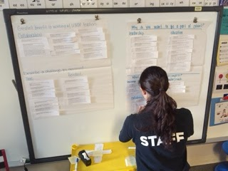
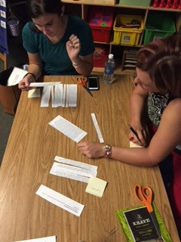
Data Analysis
Interviews and surveys were separated by question
Responses were grouped and categorized to create initial claims
Documents were analyzed for similarities and differences
Categories from different data sources were grouped to develop themes
Notes:
Hatz: Read how we analyzed our data. You can elaborate how we looked for trends in our results when we met.

Slide 16
Claims and Evidence
What level of support is necessary from site-based administration, across partnership schools, to create a system of collaboration amongst current and future teacher leaders?
Notes:
Dansby: (Read the first claim) At some of the partnership schools, there is a waiting list for participants to join UTLA. The teachers at those schools understand that this program is a very valuable experience that their administration believes in and encourages teacher participation. At other schools, it seems that school administration is less willing to promote teacher participation and it is a struggle to find and recruit teachers to continue the partnership at those schools.

Slide 17
Claims and Evidence
Literature Review
Administrative Support
Not only must teachers be full participants in any discussion about leadership roles, they must also feel supported and understood by administrators. Simply put, new and different working relationships need to be established between teachers and administrators in order for any new leadership role to make a positive and lasting contribution to the improvement of teaching and learning in a given setting (Sherrill, 1999).
Administrators, school board members, citizens, or other teachers don’t recognize or understand teacher leadership. Hence, this lack of understanding adds to the obstacles that many teacher leaders are facing (Donaldson, 2007).
Notes:
Dansby: Read STAR 1
Andrea: Read STAR 2

Slide 18
Claims and Evidence
Literature Review
Administrative Support
Teachers in teacher-powered schools report that effective "leaders among leaders" in a teacher-powered school, especially those in a principal or lead teacher position, must know how to lead from the middle or the back...they must step aside and facilitate the team toward collective decisions (Nazareno, 2015).
A teacher leader may be seen as a person in whom the dream of making a difference has been kept alive, or has been reawakened by engaging colleagues and a professional culture. Teachers are open to learning and understand the major dimensions of learning in schools: the learning of students, learning of colleagues, learning of self, and learning of the community (Lambert, 2003).
Notes:
Billett: Read STAR 1
Hatz: Read STAR 2

Slide 19
Claims and Evidence
Elevating Teacher Leadership (Killion, et. al., 2016)
Component 2: Creation of conditions for successful teacher leadership
Healthy Culture
Healthy school and school system culture are essential to the lifeblood of teacher leadership. A healthy culture supports and advances teacher leadership, and teacher leadership contributes positively to a healthy culture.
“Traditionally, teachers are considered to be at the bottom of the hierarchical levels among professional employees and beneath central office and school administrators. Because of their position in the educational hierarchy, teachers often have an uphill climb to be recognized as valued contributing members of the education workforce. Yet, their voice and engagement benefit the school system when leaders strengthen opportunities for teacher leadership.”
Notes:
Marc: Read Component 2 and briefly highlight information in each star
Andrea: Relational Trust
Dansby: Collective Responsibility
Marc: Commitment to Continuous Development
Billett: Recognition and Celebrations
Hatz: Autonomy

Slide 20
Claims and Evidence
Elevating Teacher Leadership (Killion, et. al., 2016)
Component 2: Creation of conditions for successful teacher leadership
Structure to Support Teacher Leadership
In addition to establishing a healthy culture, supportive structures must be in place that facilitate teacher leadership. Such structures include operational conditions such as procedures, resources including time, and policies that align with the school system’s purpose, definition of, and goals for teacher leadership.
“Successful systematic teacher leadership is embedded into the culture of a school and school system, yet it thrives when the structures are in place that allow teachers to succeed as leaders.”
Notes:
Marc: Read Component 2 and briefly highlight information in each star
Andrea: Role changes
Dansby: District policies and procedures
Marc: Comprehensive plan for teacher leadership
Billett: Preparation, support, and supervision
Hatz: Opportunities to lead

Slide 21
How do you view teacher leaders at your school??
Claims and Evidence
Respondent Quotes
UTLA Members
Non-UTLA Members
Teachers who are motivated, organized, take initiative, and people whom others feels they can come to for advice, suggestions, etc.
I view our teacher leaders as those who are willing to share their knowledge and areas of expertise with others.
Teacher leaders at my school are passionate and motivated to make a difference.
Awesome! Determined, responsible, dependable, and passionate.
Someone who is always willing to help out, share information, look for new ideas and strategies to implement, and someone who is not afraid to speak out.
Continuous learners seeking higher degrees who value learning and improving their craft, and have a desire to help/support others.
I think teacher leaders are prepared, have a take charge personality, and want to see some change in their school.
Notes:
Marc: Data collection – want to draw a compare and contrast to the data collected and highlight how similar the view of teacher leaders.

Slide 22
What characteristics could you associate with a teacher leader??
Claims and Evidence
Respondent Quotes
UTLA Members
Non-UTLA Members
Knowledgeable
Approachable
Accountable
Motivated
Assertive
Positive
Dedicated
Confident
Motivated to improve school
Interested in the success of others
Always learning
Looks for new ideas
Experienced
Organized
Knows how to lead others
Friendly
Notes:
Marc: Draw attention to the similarities in the expectations of the characteristics of a teacher leader.

Slide 23
Claims and Evidence
How can UTRPP stakeholders effectively communicate, to site-based faculty and staff, the connection of the partnership and the development of future Teacher Leaders?
Notes:
Hatz: Read Claim 2

Slide 24
Claims and Evidence
Literature Review
Development of Teacher Leadership
In order to be successful in teacher-powered schools, teachers need to develop the skills and abilities to be able to operate in a system where they make decisions - but not all decisions, and some of those decisions may not go their way. Key to the success of this model is absolute transparency about what decisions have been made and why (Nazareno, 2015).
Three C's contribute to an optimal relationship between principals and instructional coaches…Clarity…Communication…Collaboration. To be effective in providing professional learning that improves student achievement, coaches and principals need to develop a mutual understanding of their roles. Clarity around the coach's role and purpose helps in communicating with staff - a key to coaching success (Von Frank, 2010).
Notes:
Hatz: Read STAR 1
Dansby: Read STAR 2

Slide 25
Claims and Evidence
Literature Review
Development of Teacher Leadership
Clear communication among school members, collaborative colleague relations, participation in decision-making processes, and a healthy and supportive school climate are of critical importance for the development of teacher leadership (Klinic, Cemaloglu, & Savas 2015).
When students see and hear teachers co-creating their work environment and the politics that govern it, they learn collaborative management skills themselves. They begin to understand what active participation in a democracy looks like (Nazareno, 2015).
Notes:
Billett: Read STAR 1
Andrea: Read STAR 2

Slide 26
Claims and Evidence
Elevating Teacher Leadership (Killion, et. al., 2016)
Component 3: Cultivation of dispositions for teacher leadership
Rationale
Teacher dispositions influence the success of teacher leadership efforts. Not all teachers view themselves as leaders. Some assume that only certain teachers can be leaders, or believe they must be chosen to be a leader, often by someone in authority. These deeply held beliefs emerge from teachers’ own perceptions about their identity as a teacher and from the hierarchical structures that exist in most education systems. Building teacher agency and challenging assumptions that serve as barriers to teacher leadership are fundamental to refining and expanding teacher leadership.
Notes:
Marc: Read Component 3 and briefly discuss the underlined concepts in the rationale
Hatz: Deep commitment to student learning
Andrea: Open-mindedness and humility
Billett: Courage, willingness to take risks, and perseverance
Marc: Confidence, flexibility, and decisiveness
Dansby: Commitment and passion to ongoing learning

Slide 27
Claims and Evidence
Respondent Data
Notes:
Marc: Include to mention that in the “some understanding” category that there may be misconceptions within so this data may be altered if we look at the data through a deeper lens.

Slide 28
What do you know about UTRPP??
Claims and Evidence
Respondent Quotes
UTLA Members
Non-UTLA Members
UTRPP is a program that fosters collaboration between residents, coaches, PRT’s, and collaborating teachers. The program allows for increased field-study time for residents and coursework that directly correlates with their field-study.
UTRPP is an intense program that prepares students to become educators through coaching cycles, reflection, coursework, etc. It also gives future educators over 2,000 hours in a field experience.
I do not know of this program.
UTRPP is a pre-service teacher training program that allows residents an opportunity to have more time in the classroom while having coursework which mirrors their residency.
Interns that teach in high-poverty areas.
Program for juniors and seniors in the college of education who want to be elementary school teacher – they are also required to do a research inquiry.
Notes:
Marc: This information provided the foundation as to some of our concerns as an inquiry team because of the fact that non-UTLA members, all of which are involved in the partnership either have little or no real understanding about the program. It is in this case, and, as you will see in another piece later on in this presentation, in which are greatest concerns continue to expand.

Slide 29
Claims and Evidence
How can Teacher Leaders utilize their leadership qualities to positively impact those who lack the awareness of participation in partnership collaborative work?
Notes:
Billett: Read Claim 3

Slide 30
Claims and Evidence
Literature Review
Positive Impact
How we define leadership ‘engages and pulls others into the work of leadership’. When leadership means a person in a specific role enveloped in formal authority, teachers do not see themselves reflected in that image. When leadership becomes a broadly inclusive culture concept, it provokes a different response: I can see myself as participating in this learning work with my colleagues. Leadership realizes purpose, the sense of purpose that teachers brought with them into this profession (Lambert, 2003).
In Teacher-led schools, everyone is considered a teacher leader who makes his or her own contribution to the school's success. This dynamic creates a need to think differently about how to morph multiple perspectives into a common vision, what it means to be a leader, and how leaders learn to lead one another (Nazareno, 2015).
Notes:
Billett: Read STAR 1
Andrea: Read STAR 2

Slide 31
Claims and Evidence
Literature Review
Positive Impact
Empowering teachers to take on leadership roles enhances teachers' self esteem and work satisfaction, which in turn leads to higher levels of performance due to higher motivation, as well as possibly higher levels of retention in the profession (Muijis & Harris, 2003).
Deeper student understanding must come from deeper leading from their teachers. In order for teachers to have the ability to do this, principals must provide opportunities for teacher collaboration, invention and leadership (Berry, 2016).
New teacher leadership roles are emerging as a result of educators and policymakers seeking to improve the three major phases of the teaching career continuum; teacher preparation, induction, and ongoing professional development (Sherrill, 1999).
Notes:
Dansby: Read STAR 1
Hatz: Read STAR 2
Marc: Read STAR 3

Slide 32
Claims and Evidence
Elevating Teacher Leadership (Killion, et. al., 2016)
Component 4: Assessment of the impact of teacher leadership
Rationale
A core component of a successful system of teacher leadership is ongoing formative and summative assessment of its effects on students, peers, schools, school systems, school communities, and teacher leaders themselves. Teacher leaders and their supervisors use data about the impact of teacher leadership to adjust and refine teacher leadership programs and individual teacher leader performance. Ultimately, measuring the effects of teacher leadership provides information that may be applied to strengthen teachers’ leadership practice and its impact on peers and students.
Notes:
Marc: Read Component 4 and briefly discuss the underlined concepts in the rationale
Hatz/Dansby: Examining the overall programmatic features of teacher leadership
Andrea: Performance evaluation of individual teacher leaders
Billett: Individual and collaborative reflection that teacher leaders conduct about their practice (inquiry).

Slide 33
What do you know about UTLA??
Claims and Evidence
Respondent Quotes
UTLA Members
Non-UTLA Members
UTLA is a program that gives CTs (Collaborating Teachers) an opportunity to grow in their practice and reflect on ways to become a leader in their school and across the UTRPP schools.
UTLA helps build teacher leaders. We are learning how to be leaders and be seen as leaders in our school.
UTLA is meant for collaborating teachers to learn more in-depth about student-centered learning/coaching; provide inquiry opportunities that relates to their school, students and the partnership.
Not much, it’s required to have an intern.
Academy? Nothing.
Never heard about it.
I don’t know anything about it.
Lots of work.
The program incorporates master’s classes to help teachers become leaders in their school community by providing coaching to interns as well as other teachers. The teachers in the academy participate in the inquiry process in order to improve and reflect on their teaching.
Notes:
Marc: Once again, we see that there is clearly a misalignment between what our partnership teachers are not understanding about how to become more apart of the UTRPP program and teacher leadership. It is with this information that we further support our claim that it is up to us to reach across the partnership into the schools and let all of our faculty and staff hear and see the amazing work our teacher leaders are doing, behind the scenes, to advance the success of the program and partnership.

Slide 34
Implications
Improve the communication between the Urban Teacher Leadership Academy and the administration, faculty, staff and leadership team at UTRPP schools through on-going Professional Development.
Provide teacher leaders the opportunity to lead collaborations, as facilitators of professional growth and development, across the partnership and beyond.
Notes:
Billett: Read STAR 1
Hatz: Read STAR 2

Slide 35
Future Wonderings
How do we continue to empower Teacher Leaders to have a voice within the leadership of the partnership?
How do we continue to recruit and sustain Teacher Leadership?
What Professional Development will Teacher Leaders facilitate to site-based and partnership schools?
Notes:
Andrea: Read STAR 1
Dansby: Read STAR 2 - This is just the beginning of our partnership program, it will continue to grow and change as we empower current participants to inspire and encourage the teachers at their sites to step up and become future leaders.
Marc: Read STAR 3

Slide 36
Any questions???
Thank you for your time! If you have any further questions, please feel free to contact us at any time!
Notes:
Marc: Ask for questions

Slide 37
Ms. Kimberly Billett Dr. Marc J. Summa 3rd Grade Teacher Partnership Resource Teacher Witter Elementary School UTRPP @ USF/HCPS kimberly.billett@sdhc.k12.fl.us summam@mail.usf.edu Ms. Karen Dansby Mrs. Beth Hatzifrangou 2nd Grade Teacher Kindergarten Teacher Mort Elementary School Mort Elementary School karen.dansby@sdhc.k12.fl.us beth.hatzifrangou@sdhc.k12.fl.us Mrs. Andrea Jones-Lang 3rd Grade Teacher USF-Patel Partnership School andrea.jones-lang@sdhc.k12.fl.us
Contact Information
Notes:
Marc: Here is our contact information in case anyone is interested in finding out more about our program and the amazing work that is being done by all stakeholders in UTRPP. (I have business cards if anyone needs immediate contact information)

Slide 38
References
Berry, B. (2016). Is Your Teacher Leadership Program Outdated? Retrieved
from ebscohost.com
Cowdery, J. (2004) Getting it right: Nurturing an environment for teacher-leaders, Kappa Delta Pi Record, 40(3), 128-131. DOI:10.1080/00228958.2004.10516422
Donaldson Jr., G. A. (2007). What Do Teachers Bring To Leadership?
Educational Leadership, Vol. 65, No. 1.
Killion, J., Harrison, C., Colton, A., Bryan, C., Delehant, A., & Cooke, D. (2016).
A systematic approach to elevating teacher leadership. Oxford, OH: Leaning
Forward.
Klinic, A.C., Cemaloglu, N., & Savas, G. (2015). The relationship between
teacher leadership, teacher professionalism, and perceived stress. Eurasian
Journal of Educational Research, 58, 1-26. http://dx.doi.org/10.14689/eje.
2015.58.5

Slide 39
References
Lambert, L. (2003). Leadership Redefined: An evocative context for teacher
leadership. School leadership & management, 23(4), 421-430.
Muijis, D. and Harris, A. (2003). Teacher Leadership – Improvement through
Empowerment? An Overview of the Literature. Educational Management
and Administration, 31.4. Pgs. 437-448.
Nazareno, Lori (2015). If I Could Run a School: Teacher Powered Schools
Require a Divergent Set of Skills. Vol. 36, No. 4.
Sherrill, J. A. (1999). Preparing Teachers for Leadership Roles in the 21st
Century. Theory into Practice, 38 (1), 56-61.
Von Frank, V. (2010). Clarify the Coaches Role – Solid Partnership with the
Principal is Key to Effectiveness. The Learning Principal. National Staff
Development Council V. 5, No. 5.

